Slide 1

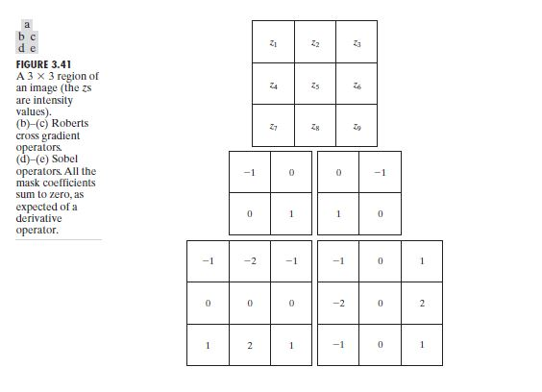
Digital Image Processing
22- Edge detection

Slide 2


Digital Image Processing
22- Edge detection

